Slide 1
Demo

Slide 2
Outline
Introduction
Body tracking
Deep Learning
System setup
Results

Slide 3
Outline
Introduction
Body tracking
Deep Learning
System setup
Results

Slide 4
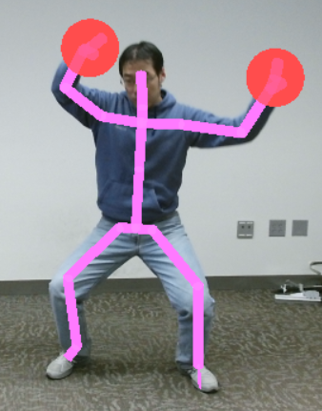
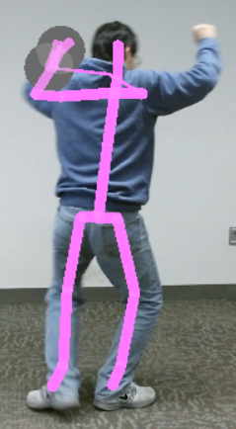
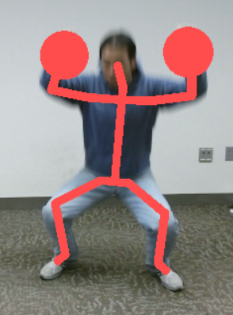
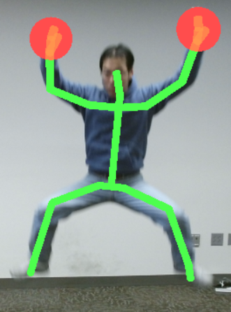
Introduction I – Body tracking
The essence of body tracking is to detect joints.
Kinect sensor can track human body.
1. Compute depth map
2. Infer body position by machine learning
Kinect has two shortcomings
Cannot tell whether a person is facing to or turn around
Joints detection is not very accurate.

Slide 5
Outline
Introduction
Body tracking
Deep Learning
System setup
Results

Slide 6
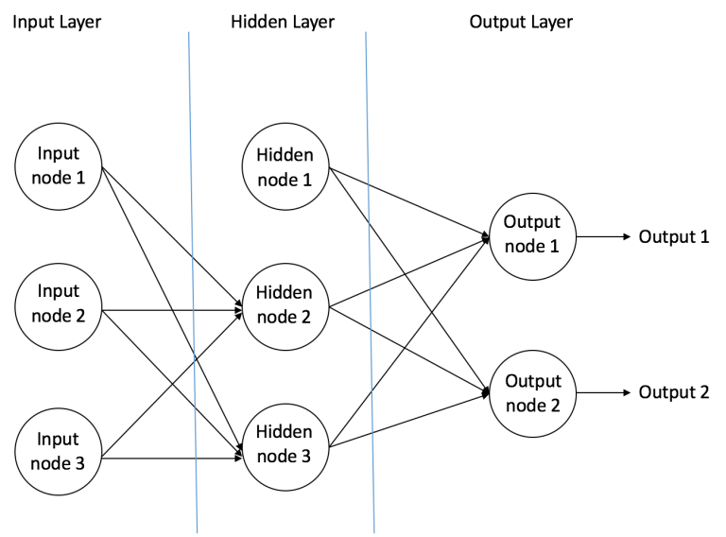
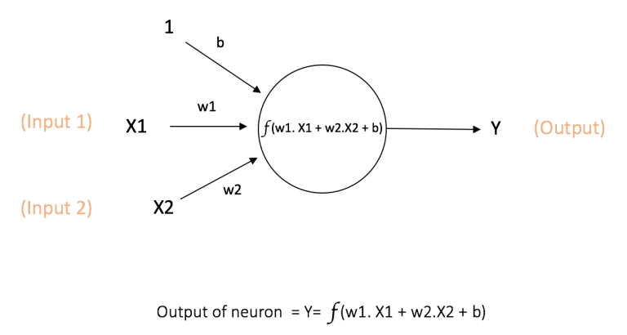
Introduction II – Deep Learning
Neural Network (NN)
Convolutional Neural Network (CNN)

Slide 7
Introduction II – Deep Learning
Convolutional Neural Network (CNN)
There are 4 main operations in CNN
1. Convolution
1. Convolution 2. Non Linearity 3. Pooling 4. Classification
2. Non Linearity
3. Pooling
4. Classification

Slide 8
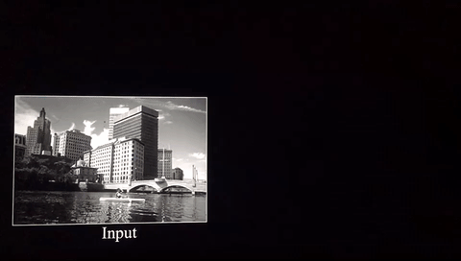
Introduction II – Deep Learning
Convolutional Neural Network (CNN)
There are 4 main operations in CNN
1. Convolution 2. Non Linearity 3. Pooling 4. Classification
Depth – number of filter
Stride
Zero-padding
Notes:
Some images are from https://ujjwalkarn.me/2016/08/11/intuitive-explanation-convnets/

Slide 9
Introduction II – Deep Learning
Convolutional Neural Network (CNN)
There are 4 main operations in CNN
1. Convolution 2. Non Linearity 3. Pooling 4. Classification
F(x) = max(0,x)
Rectified Linear Unit

Slide 10
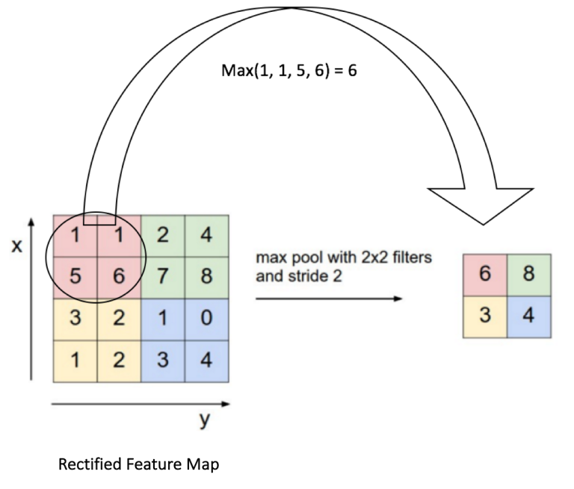
Introduction II – Deep Learning
Convolutional Neural Network (CNN)
There are 4 main operations in CNN
1. Convolution 2. Non Linearity 3. Pooling 4. Classification
Max
Average
Sum

Slide 11
Introduction II – Deep Learning
Convolutional Neural Network (CNN)
There are 4 main operations in CNN
1. Convolution 2. Non Linearity 3. Pooling 4. Classification

Slide 12
Introduction II – Deep Learning
Convolutional Neural Network (CNN)
There are 4 main operations in CNN
1. Convolution 2. Non Linearity 3. Pooling 4. Fully connected layer

Slide 13
Introduction II – Deep Learning
Convolutional Neural Network (CNN)
There are 4 main operations in CNN
1. Convolution 2. Non Linearity 3. Pooling 4. Fully connected layer
The term “Fully Connected” implies that every neuron in the previous layer is connected to every neuron on the next layer.
In the output layer, a classifier like SVM can be used.

Slide 14
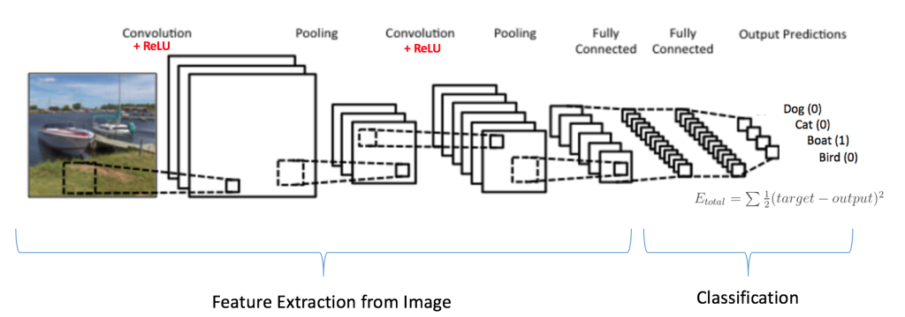
Introduction II – Deep Learning
Convolutional Neural Network (CNN)
There are 4 main operations in CNN
1. Convolution 2. Non Linearity 3. Pooling 4. Classification

Slide 15
Outline
Introduction
Body tracking
Deep Learning
System setup
Results

Slide 16
System setup
Kinect V2
Desktop with GTX1070
Color
Joints
Kinect
2D Joints detection
2D to 3D
Render
Images
Depth
images
Mask
images

Slide 17
System setup
Kinect V2
Desktop with GTX1070
Color
Joints
Kinect
2D Joints detection
2D to 3D
Render
Images
Depth
images
Mask
images
2 threads
Read data
Push data
1 thread
Process data
1 thread
Transform 2D to 3D and render

Slide 18
System setup – detail I (Kinect)
Kinect
Color Images
(1920 x 1080)
Mask images
(512 x 424)
Depth images
(512 x 424)

Slide 19
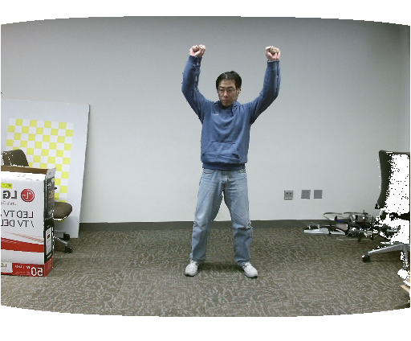
System setup – detail I (Kinect)
Kinect
Color Images
( 512 x 424)
Mask images
(512 x 424)
Depth images
(512 x 424)

Slide 20
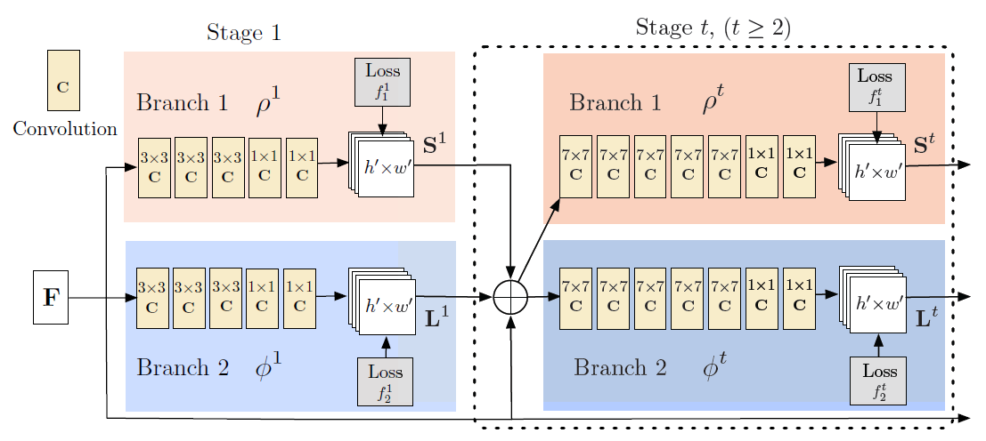
System setup – detail II(Rtpose)
Realtime Multi-Person 2D Pose Estimation using Part Affinity Fields
Zhe Cao et al.
Modified Caffe network
Trained model

Slide 21
System setup – detail III(Render)
1. Find joints on depth image
2. Turn 2D depth image to 3D points cloud
3. Do triangulation on points cloud to produce meshes
4. According to mask image, use OpenGL render meshes with joints

Slide 22
Outline
Introduction
Body tracking
Deep Learning
System setup
Results

Slide 23
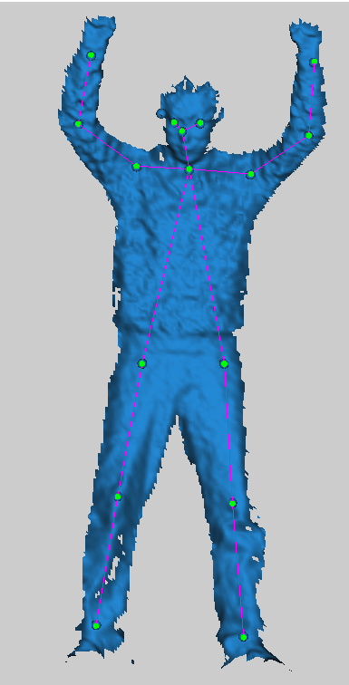
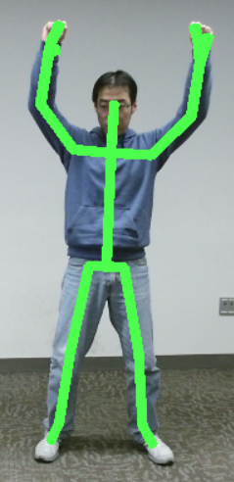
Results

Slide 24
Results

Slide 25
Results

